Slide 1
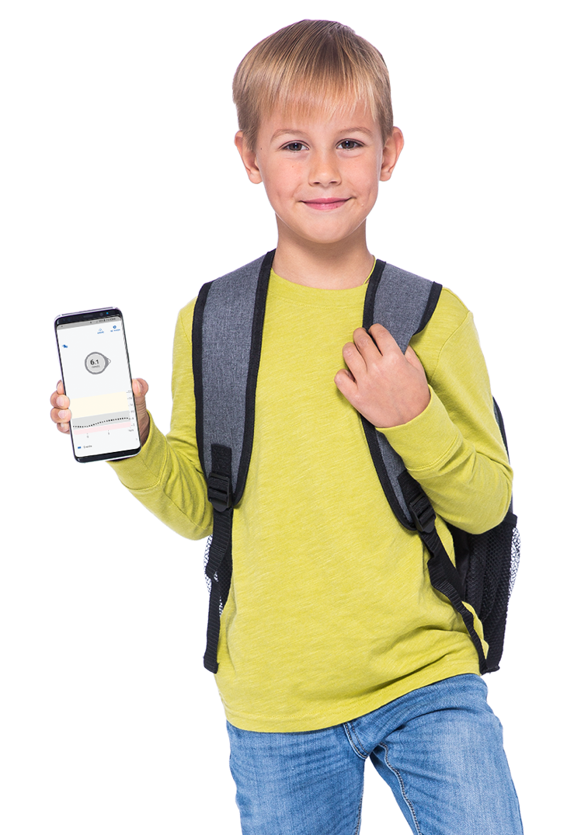


School Guide

Slide 2

Introduction
Welcome
Welcome to the Dexcom G6 Continuous Glucose Monitoring (CGM) School Guide.
The purpose of this guide is to define CGM, explore the differences between CGM and a blood glucose meter (meter), and explore how your students might use CGM.
This guide is for concept illustration only. For detailed step-by-step instructions on how to use the Dexcom G6 CGM System, please refer to the user guide.
ALWAYS READ THE LABEL AND USE ONLY AS DIRECTED.

Slide 3
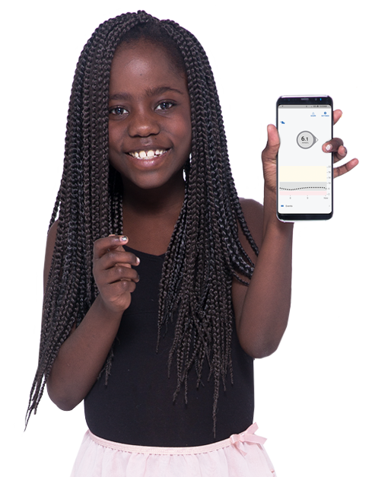
Introduction
Guide Goals
This guide will introduce you to the basics of CGM. It will discuss:
  Having a plan for diabetes management at school
  The Dexcom G6 CGM System (G6)
  The difference between CGM and a meter
  How you may use CGM to help a student

Slide 4
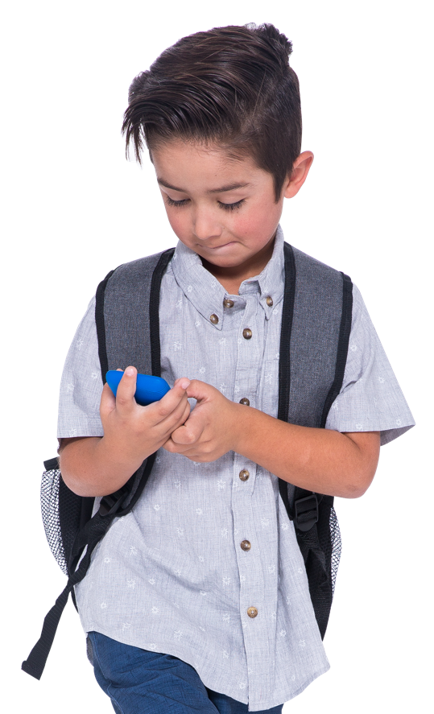
Diabetes Management Plan
It is a good idea to have a written diabetes management plan at school. Possible contents include:
  List trained diabetes staff and date of training
  Level of student’s independence with diabetes self care
  Location of and access to diabetes management supplies
  When to contact Parent/Guardian
  Healthcare team general contact details
  Low/high glucose treatments – location, type and unrestricted student access to these
  CGM Information and use of CGM devices in the school setting
  Unrestricted access to snacks, water and bathroom
This is not a complete list

Slide 5
What is CGM?
A Continuous Glucose Monitoring (CGM) is a small wearable medical device, that continuously reads glucose levels, through a tiny sensor beneath the skin. It wirelessly (via Bluetooth) sends glucose levels every 5 minutes to a compatible display device, typically a smartphone. It also shows where the glucose is headed, which helps to make informed decisions about diabetes management. It also alerts the wearer if glucose levels are going too low, or too high to help avoid severe health risks.

Slide 6
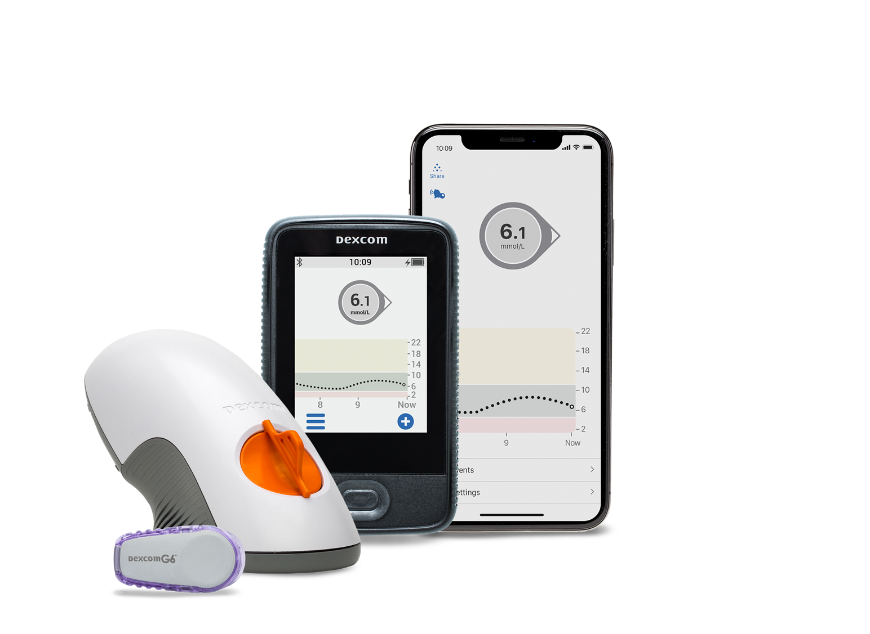
Dexcom G6 app* or Receiver**: Displays glucose information and provides Alarm/Alerts
Applicator with sensor: Applicator inserts sensor under skin and sensor gets glucose information
Transmitter: Affixed to sensor and wirelessly sends data to display device
* For a list of compatible devices see: dexcom.com/compatibility
** In this guide, we will only be discussing the smart device option.

Slide 7

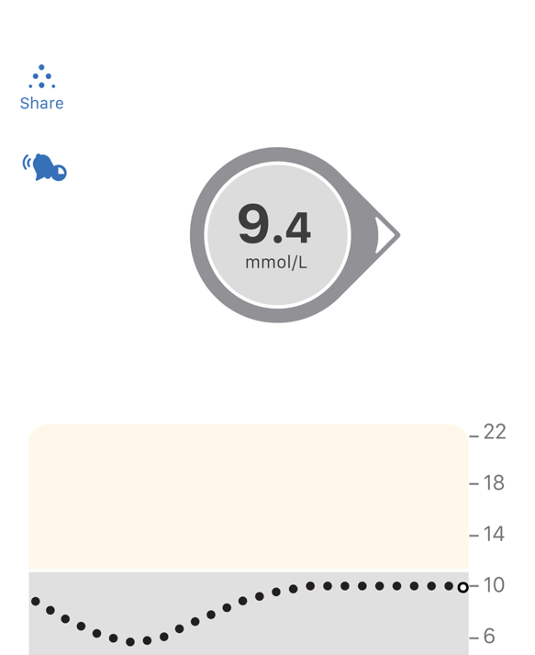
Smart Device Use
Smart Device
If the student uses a smart device it will need to be with them at all times and the volume will need to be loud enough to hear low and high alerts.
The Dexcom G6 app is on a phone and is considered a medical device and should not be removed from the student's range of connectivity (6 metres)

Slide 8

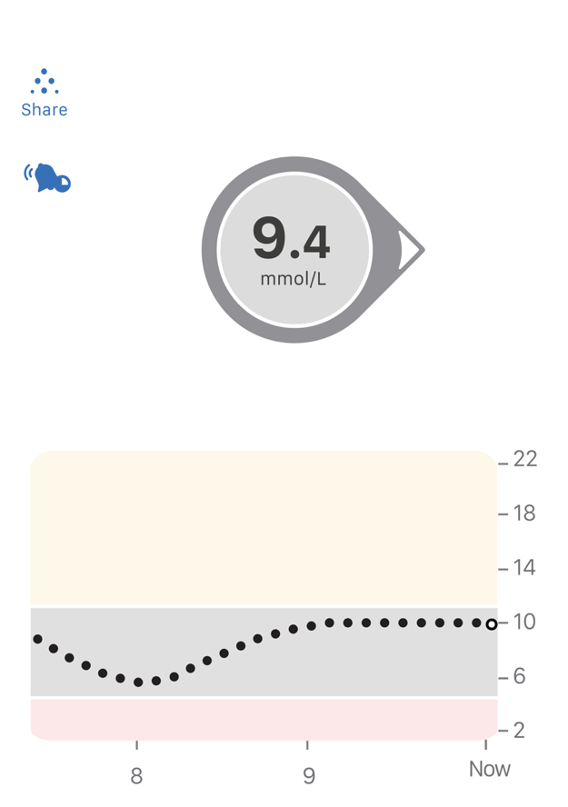
Dexcom Share: A student can share glucose information with up to 10 people
Current Glucose: Shows where the student’s glucose is now
Trend Arrow: Shows a student’s glucose speed and direction
High Alert Level: The student will be alerted when glucose rises above this level
Trend Graph: Shows a student’s glucose over the past 3 hours
Low Alert Level: The student will be alerted when glucose falls below this level

Slide 9

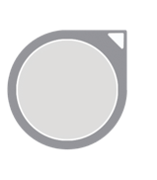
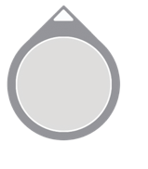
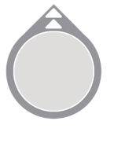

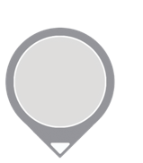
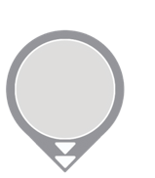
Trend Arrows
Trend arrows shows a student’s glucose speed and direction. This helps to make informed treatment decisions.
Constant
Slowly Rising
Rising
Rapidly Rising
Changing less than
0.06 mmol/L per minute or up to 0.8 mmol/L
in 15 minutes
Rising 0.06-0.1 mmol/L each minute or up to 1.7 mmol/L in 15 minutes
Rising 0.1-0.2 mmol/L each minute or up to 2.5 mmol/L in 15 minutes
Rising more than
0.2 mmol/L each minute or more than 2.5 mmol/L
in 15 minutes
Slowly Falling
Falling
Rapidly Falling
Falling 0.06-0.1 mmol/L each minute or up to 1.7 mmol/L
in 15 minutes
Falling 0.1-0.2 mmol/L each minute or up to 2.5 mmol/L in 15 minutes
Falling more than 0.2 mmol/L each minute or more than 2.5 mmol/L
in 15 minutes
Notes:
Trend arrows show the speed and direction your glucose is heading. Trend arrows can help you catch highs and lows before they happen.

Slide 10
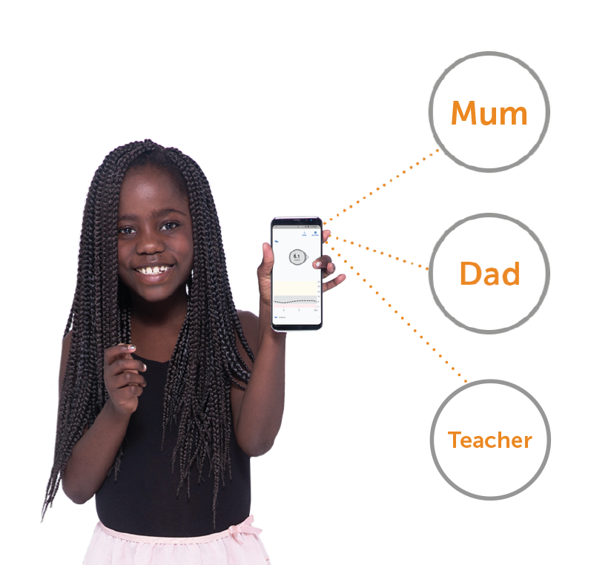

Dexcom Share
The G6 app has the built-in Dexcom Share feature, where up to 10 followers can monitor a student’s glucose from their smart device.
Followers can be parents, spouses, grandparents, caregivers or even you.

Slide 11
Dexcom Share
The student wearing the G6 is known as the Sharer. To share glucose information with Followers, the student will need:
  The Dexcom G6 app on a compatible device* with internet connection
  This is the same app the student uses to receive their glucose information
A parent may ask for use of school Wi-Fi to use Share.
* For a list of compatible devices see: dexcom.com/compatibility

Slide 12
Dexcom Follow
What the Follower Needs
To receive the student's glucose information, Followers will need to install the Dexcom Follow app on a compatible smart device* and have internet connectivity. When someone is added as a Follower they will be sent an email with instructions.
Any diabetes treatment decision should be based on the student’s G6, not information from the Dexcom Follow app.
Dexcom Follow App
* For a list of compatible devices see: dexcom.com/compatibility

Slide 13
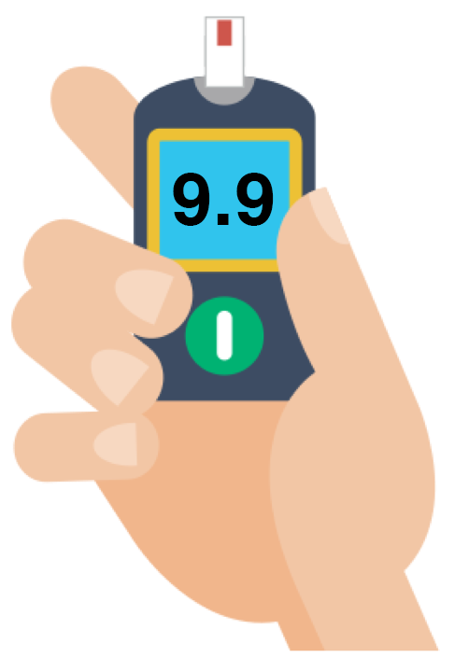
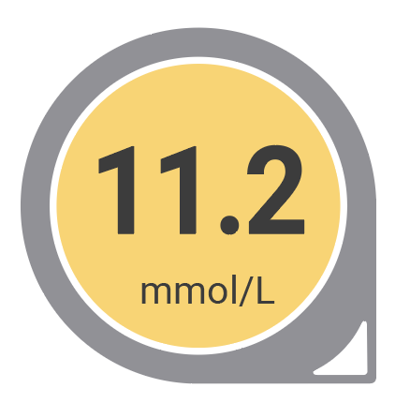
Accuracy
G6 readings and meter values may not be the same and it is not always a concern.
The G6 and a meter measure glucose from two different types of body fluids: interstitial fluid and blood.
CGM are considered accurate if the sensor is within 20% of the meter result. Readings can be different and still fall into their accurate range.

Slide 14
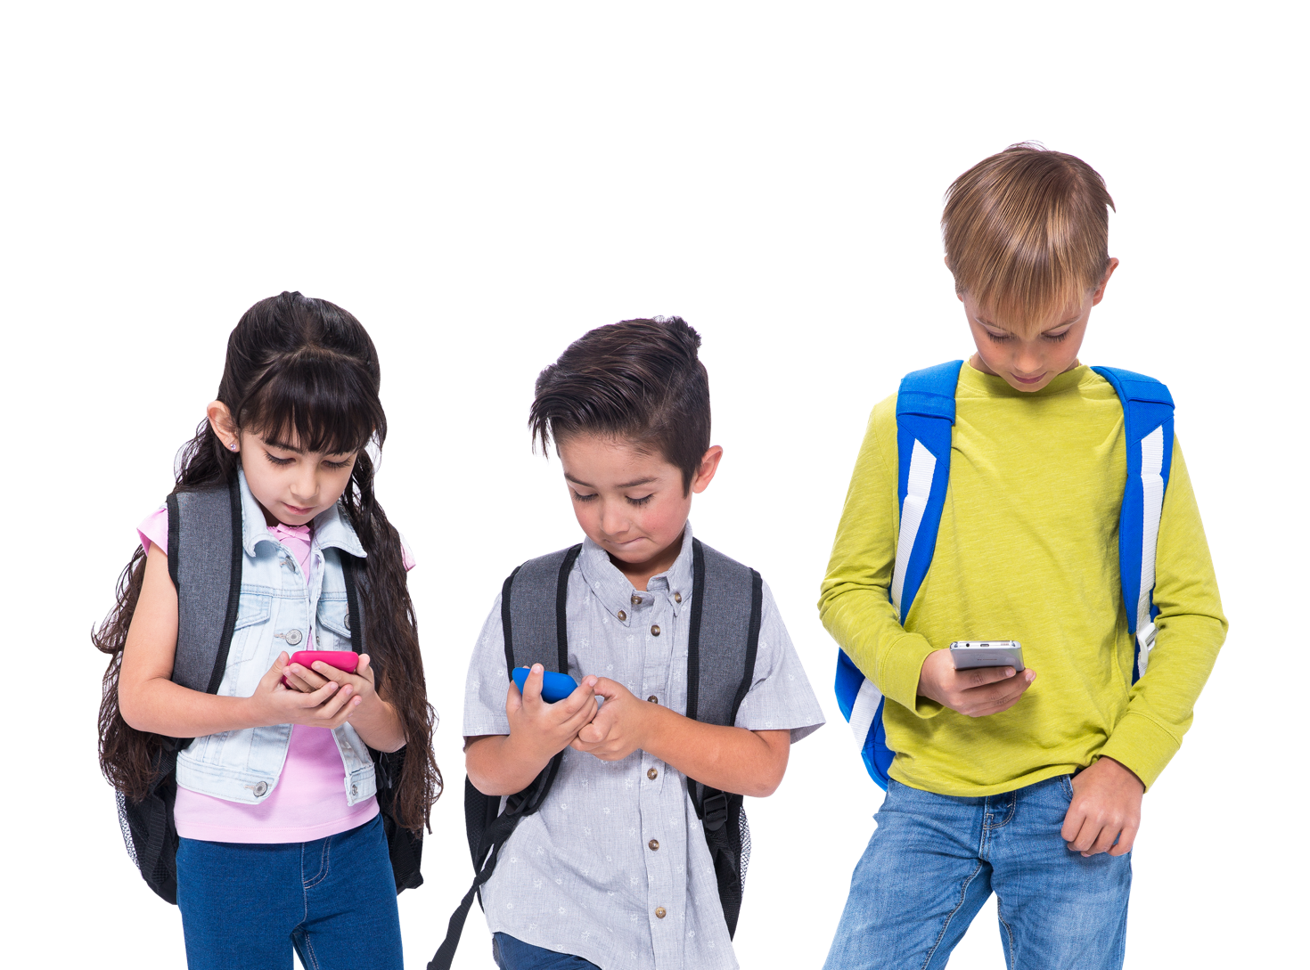
CGM in School
How will you use CGM?
Students may come to see you for a variety of reasons regarding their CGM.
The next few screens explore how you may use CGM in a school setting.

Slide 15
Treatment Decisions
Treatment Decisions
A student may come to you to treat a low or high glucose level. The G6 can be used to make treatment decisions such as eating for a low glucose level or dosing insulin for a high glucose level. Base treatment decisions on the student’s diabetes management plan.
Use a meter:
If a number and an arrow are not shown on the G6 app
Any time the student’s symptoms don’t match readings. For example, if a student says they feel low but the G6 shows them in a normal range.

Slide 16

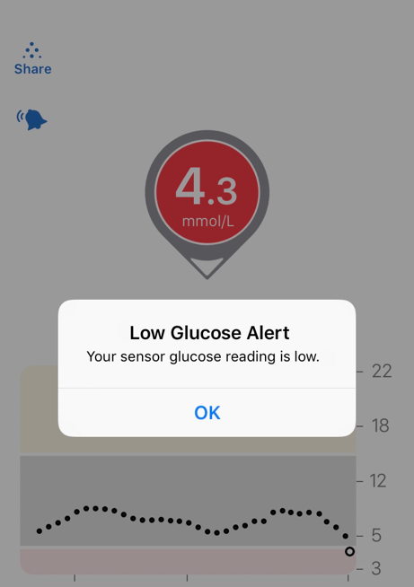
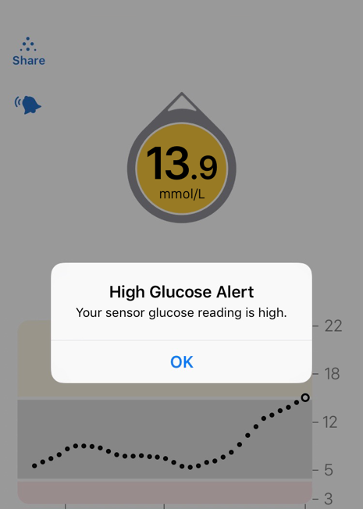
Low and High Alerts
Responding to Low and High Glucose Alerts
Each student should have a personalised set low and high glucose alert.
The display device will either vibrate or beep based on the student's alert settings.

Slide 17

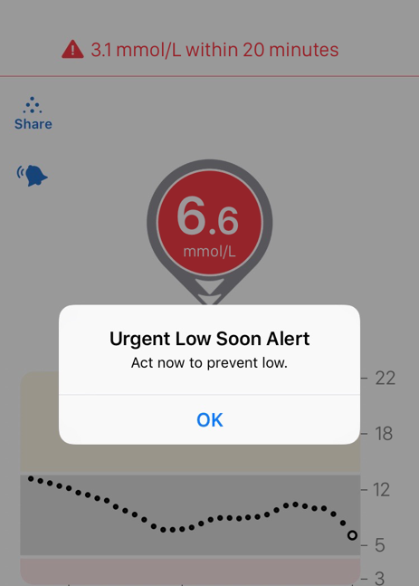
Urgent Low Soon
This is a predictive alert which can be set as a warning of impending hypo/low glucose events. It sounds when a student will be 3.1 mmol/L in less than 20 minutes.
Depending on how quickly the student will be at 3.1mmol/L, they will either get their Urgent Low Soon Alert or their Low Alert:
  Within 20 minutes = Urgent Low Soon Alert
  Not that fast = Low Alert
This alert can be turned on or off in settings.

Slide 18
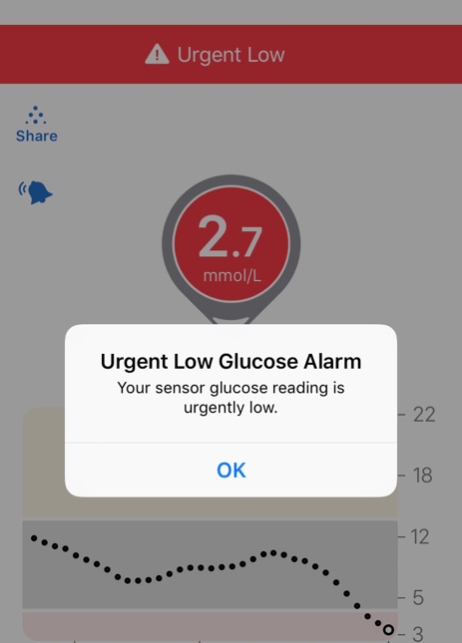
Urgent Low Alarm
There is also the Urgent Low Alarm that lets you know when the student’s sensor glucose is at or below a glucose level of 3.1 mmol/L.
This Alarm can’t be changed or turned off.

Slide 19
Responding to Alerts and Alarms
Responding to Low and High Glucose Alerts
Based on the student’s individualised diabetes management plan, a student may come to you to help respond to alerts and alarms.
The steps you should take are:
  Go into the G6 app on the student's smart device
  Tap OK to clear the alert
  Take action based on the glucose information shown in the G6 app and the diabetes management plan

Slide 20
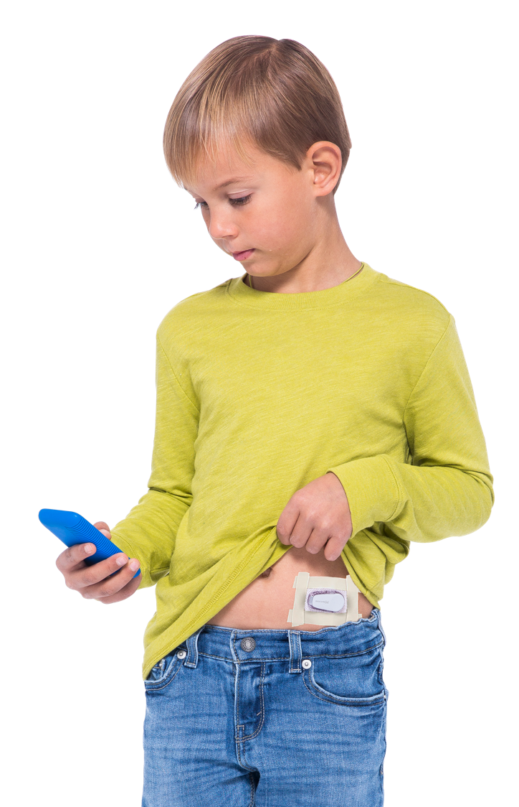
Adhesive
The sensor should stay securely attached to the skin using its own adhesive. If the patch starts falling off or peeling around the edges, you can use medical tape to secure it to the body.
Tape over the white adhesive patch on all sides for even support
Do not tape over the transmitter, or any plastic parts

Slide 21
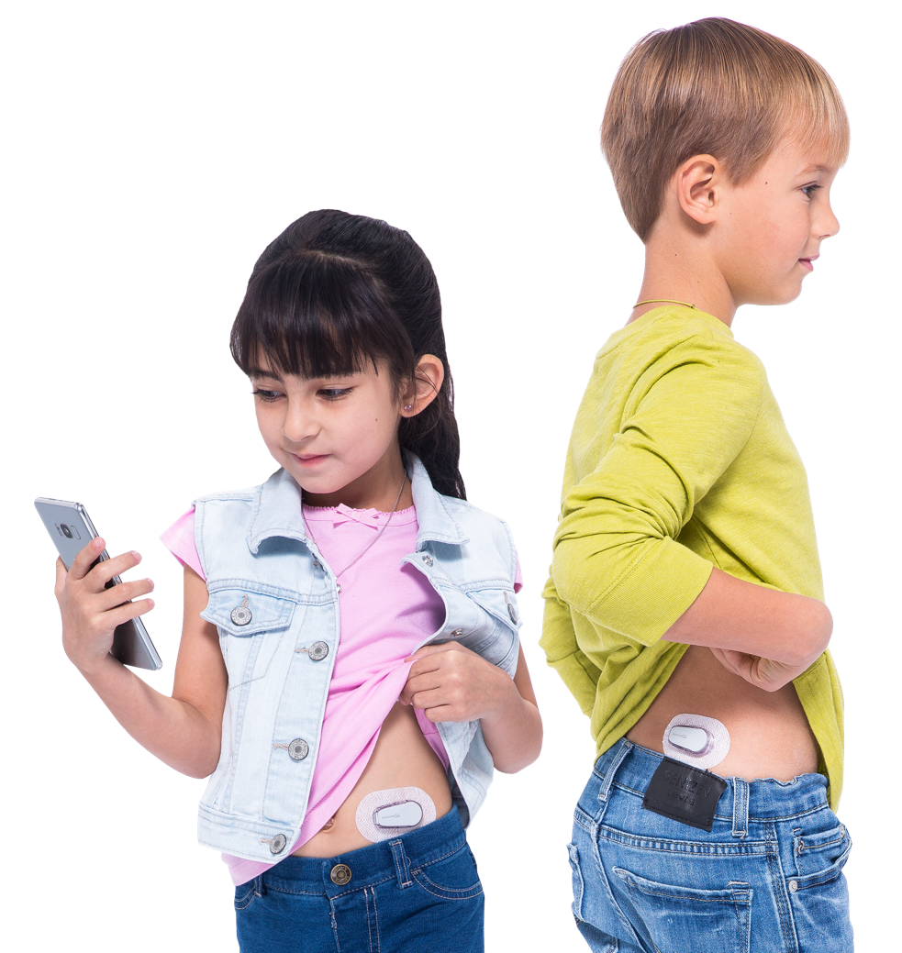
Sensor Insertion
Sensor Insertion
You may need to help a student with sensor insertion. Sensor insertion should be outlined in the diabetes management plan.

Slide 22

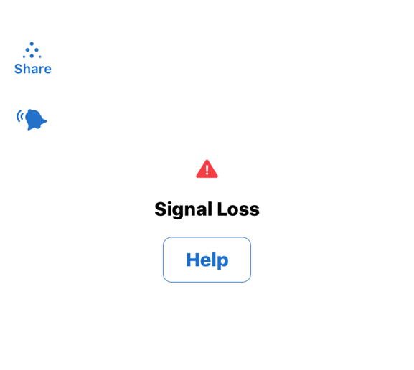
Troubleshooting
A student may come in for help with a screen they have never seen before. Use a meter for treatment decisions if an error is shown.
For troubleshooting tips, tap Help for more information

Slide 23
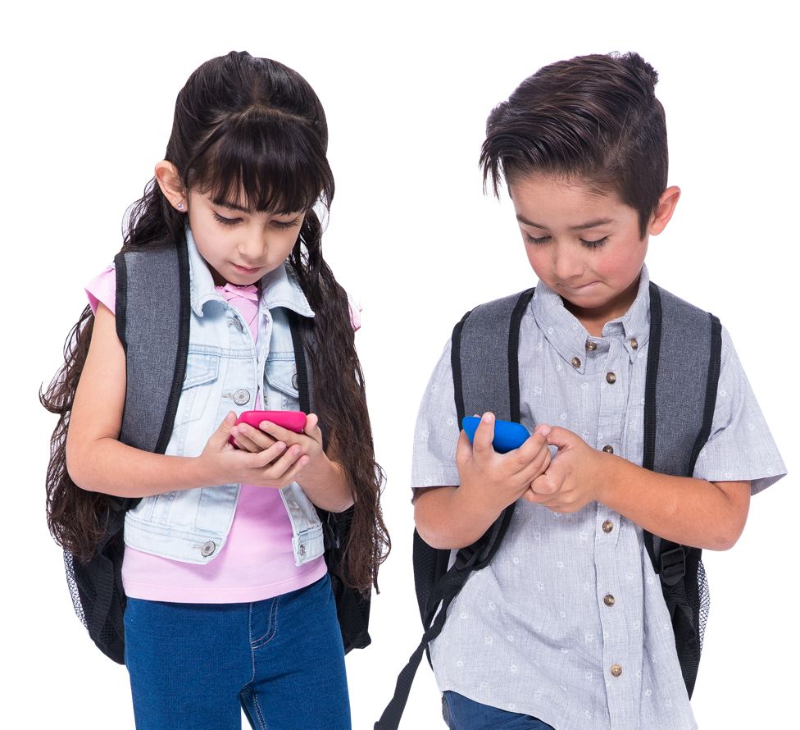
Additional Help
For additional technical support:
Our 24/7 Customer Technical Support can be reached on 1300 851 056
Or
Email us at diabetes.techsupport@amsl.com.au with non urgent queries

Slide 24
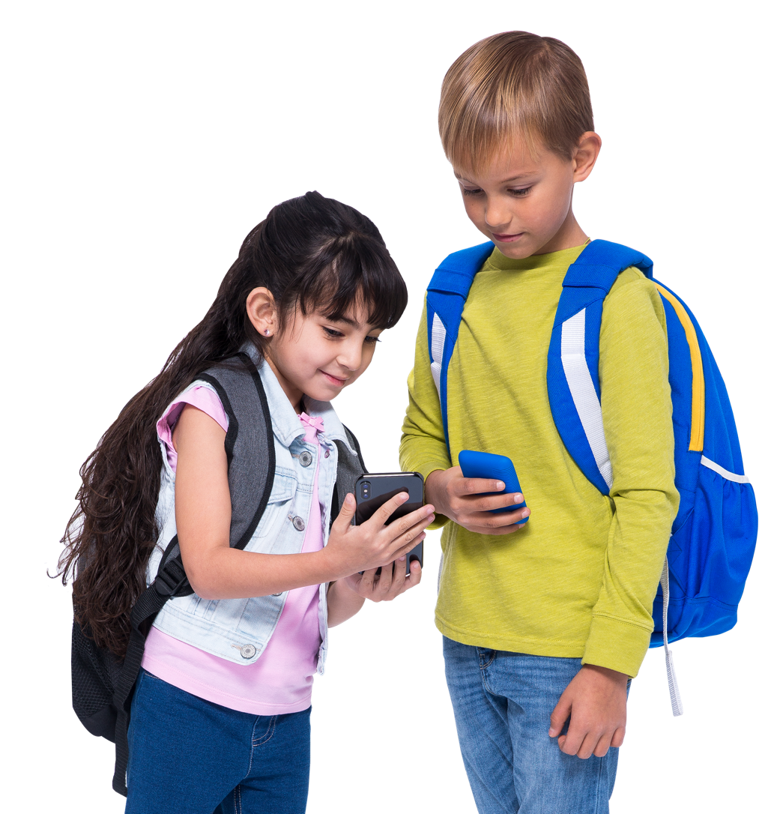
Every Student is Unique
If other issues come up regarding the student and their CGM, speak to the main caregiver, who in consultation with their healthcare team can adjust the diabetes management plan as required.

Slide 25

Your Choice. Your Life. Your Freedom.®
amsldiabetes.com.au 1300 851 056
LBL016957 Rev003 March 2022. AMSL is a subsidiary of Dexcom.
2 McCabe Place, Chatswood NSW 2067.
©2022 Dexcom, Inc. All rights reserved.

